Slide 1
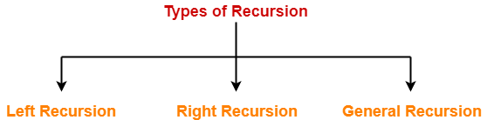
Left-Recursion
Left-Recursion S → Sa / ∈
Right-Recursion S → aS / ∈
General-Recursion S → aSb / ∈
A production of grammar is said to have left recursion if the leftmost variable of its RHS is same as variable of its LHS.
A grammar containing a production having left recursion is called as Left Recursive Grammar.

Slide 2
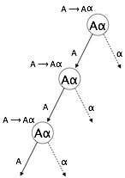
Left-Recursion
A → Aα / β
Left recursion is considered to be a problematic
situation for Top down parsers.
Therefore, left recursion has to be eliminated from
the grammar.
Left-Recursion Elimination
we can eliminate left recursion by replacing the pair
of productions with-
A → βA’
A’ → αA’ / ∈

Slide 3
Left-Recursion
Problem-1: Consider the following grammar and eliminate left recursion-
A → AAα / β
Solution:
The grammar after eliminating left recursion is-
A → βA’
A’ → AαA’ / ∈
Problem-2: Consider the following grammar and eliminate left recursion-
S → S0S1S / 01
Solution:
The grammar after eliminating left recursion is-
S → 01A
A → 0S1SA / ∈

Slide 4
Left-Recursion
Problem-3: Consider the following grammar and eliminate left recursion-
A → ABd / Aa / a
B → Be / b
Solution:
The grammar after eliminating left recursion is-
A → aA’
A’ → BdA’ / aA’ / ∈
B → bB’
B’ → eB’ / ∈
Problem-4: Consider the following grammar and eliminate left recursion-
E → E + E / E x E / a
Solution:
The grammar after eliminating left recursion is-
E → aA
A → +EA / xEA / ∈

Slide 5
Left-Factoring
Left factoring is a process by which the grammar with common prefixes is transformed to make it useful for Top down parsers.
Example
A → αβ1 / αβ2 / αβ3
This kind of grammar creates a problematic situation for Top down parsers.
Top down parsers can not decide which production must be chosen to parse the string in hand.
To remove this confusion, we use left factoring.

Slide 6
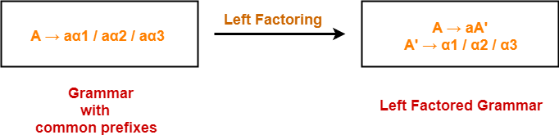
Left-Factoring

Slide 7
Left-Factoring
Problem-1: Do left factoring in the following grammar-
A → aAB / aBc / aAc
A → aA’
A’ → AB / Bc / Ac
A → aA’
A’ → AD / Bc
D → B / c
This is a left factored grammar.

Slide 8
Left-Factoring
Problem-2: Do left factoring in the following grammar-
S → aSSbS / aSaSb / abb / b
S → aS’ / b
S’ → SSbS / SaSb / bb
S → aS’ / b
S’ → SA / bb
A → SbS / aSb
This is a left factored grammar.

Slide 9
Left-Recursion vs Left-Factoring
Left Recursion: A grammar is left recursive if it has a nonterminal A such that there is a derivation A -> Aα | β where α and β are sequences of terminals and nonterminals that do not start with A.
While designing a top down-parser, if the left recursion exist in the grammar then the parser falls in an infinite loop, here because A is trying to match A itself, which is not possible. We can eliminate the above left recursion by rewriting the offending production. As-
A -> βA'
A' -> αA' | epsilon
Left Factoring: Left factoring is required to eliminate non-determinism of a grammar. Suppose a grammar, S -> abS | aSb
Here, S is deriving the same terminal a in the production rule(two alternative choices for S), which follows non-determinism. We can rewrite the production to defer the decision of S as-
S -> aS'
S' -> bS | Sb
Thus, S' can be replaced for bS or Sb

Slide 10

FIRST and FOLLOW
FIRST
First(α) is a set of terminal symbols that begin in strings derived from α.
Consider the production rule-
A → abc / def / ghi
Then, we have- First(A) = { a , d , g }

Slide 11
FIRST and FOLLOW
FIRST
For a production rule X → ∈,
First(X) = { ∈ }
For any terminal symbol ‘a’,
First(a) = { a }

Slide 12
FIRST and FOLLOW
FOLLOW
Follow(α) is a set of terminal symbols that appear immediately to the right of α.
For the start symbol S, place $ in Follow(S).
For any production rule A → αB,
Follow(B) = Follow(A)
For any production rule A → αBβ,
If ∈ ∉ First(β), then Follow(B) = First(β)
If ∈ ∈ First(β), then Follow(B) = { First(β) – ∈ } ∪ Follow(A)

Slide 13
FIRST and FOLLOW
∈ may appear in the first function of a non-terminal.
∈ will never appear in the follow function of a non-terminal.
Before calculating the first and follow functions, eliminate Left Recursion from the grammar, if present.

